Slide 1

DEEP LEARNING WITH TENSORFLOW
FEB 20 - MAR 29
Mondays and Wednesdays
6:30pm - 9:30pm
Sam Abrahams

Slide 2
https://tinyurl.com/z3cx82c
Link to slides:

Slide 3
For the presentation today:
Ask questions in the chat box
Link to slides: https://tinyurl.com/z3cx82c
This will be recorded
Presentation itinerary:
Slides: Deep learning context and course outline
Q/A
Light demo: using a pre-trained network with TensorFlow
Q/A
Admissions: amy@thisismetis.com

Slide 4
ABOUT THE INSTRUCTOR
Creator, Deep Learning with TensorFlow
Co-author, TensorFlow for Machine Intelligence
Consultant, Memdump
Maintainer, TensorFlow on Raspberry Pi
Long time contributor, TensorFlow
GitHub: samjabrahams Twitter: @Sabraha

Slide 5
Deep Learning

Slide 6
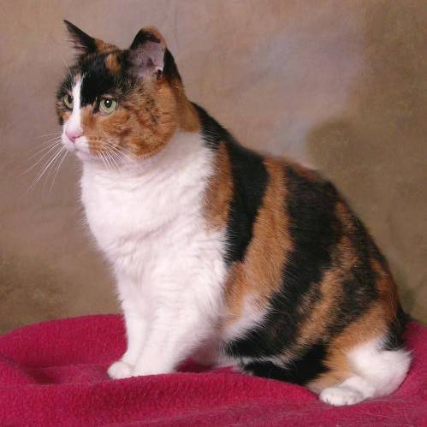
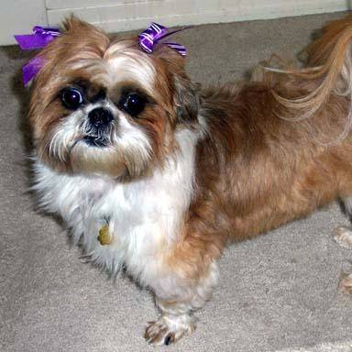
A Question:
OR
?

Slide 7
By hand?

Slide 8
By hand?
?

Slide 9
Making good, complex features by hand isn’t practical
What if:
A computer could do it for us?

Slide 10
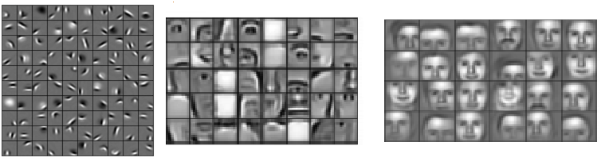
Example: recognizing faces
from NVIDIA’s devblog

Slide 11
Deep Learning
Computer uses complex combinations of inputs
Incredibly powerful with unstructured data, e.g. :
Images
Audio
Text

Slide 12
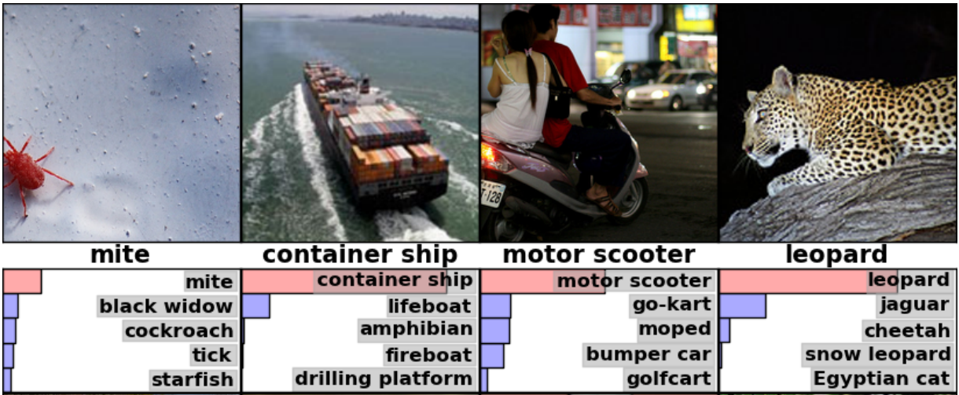
Image Classification

Slide 13
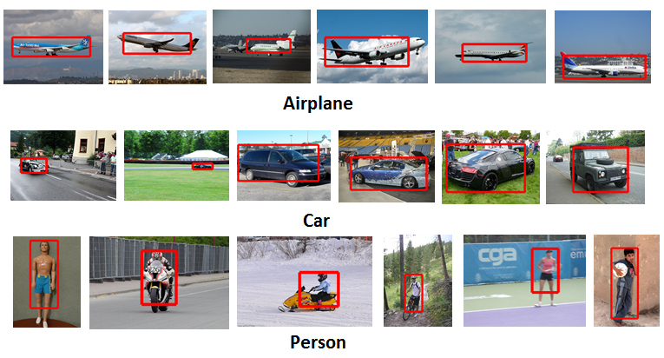
Object detection

Slide 14
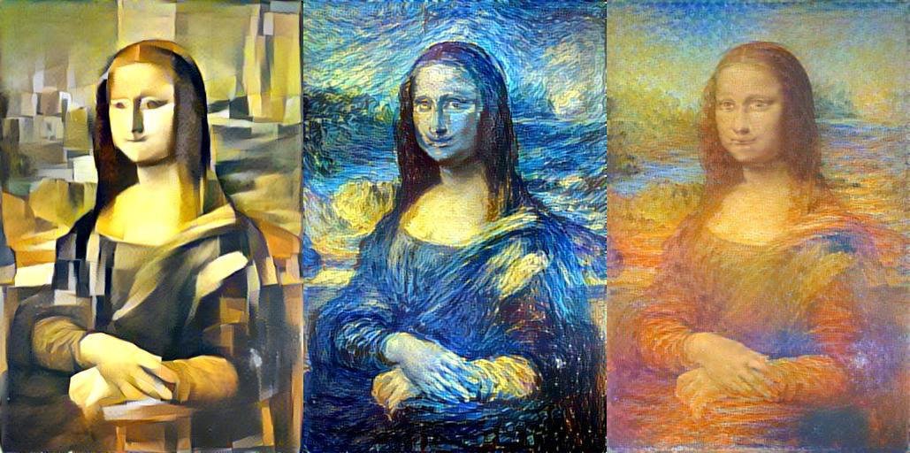
Style Transfer

Slide 15
Natural Language Processing
Machine translation
Grammatical parsing
Text-to-speech audio generation
Question answering

Slide 16
You provide the what.
Deep learning finds the how.

Slide 17
TensorFlow

Slide 18

What is TensorFlow?
Open source math library
Designed especially for machine learning
Single machines, clusters, and mobile/low power devices

Slide 19
Why TensorFlow?

Slide 20
Key benefits
Flexible
Scalable
Compatible
Deployable

Slide 21
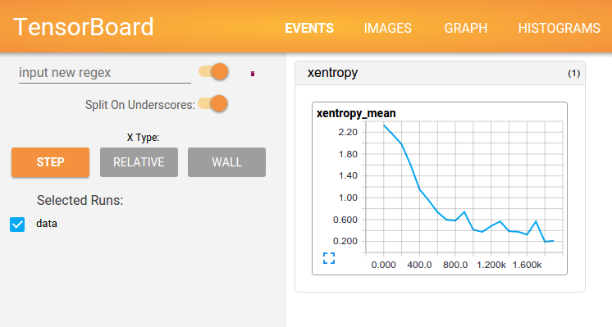
TensorBoard

Slide 22
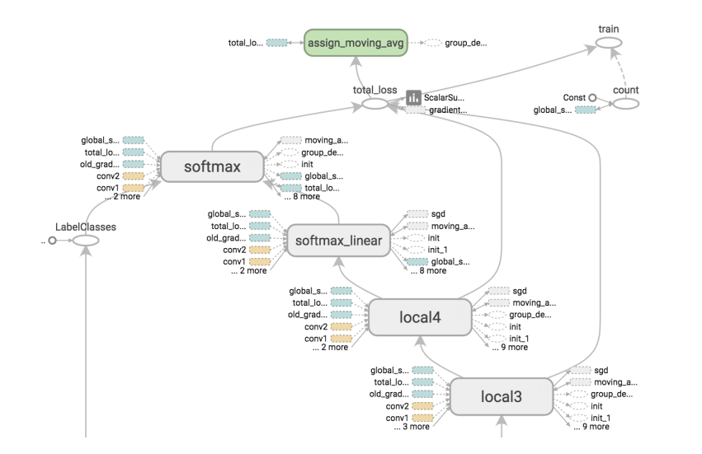
TensorBoard

Slide 23
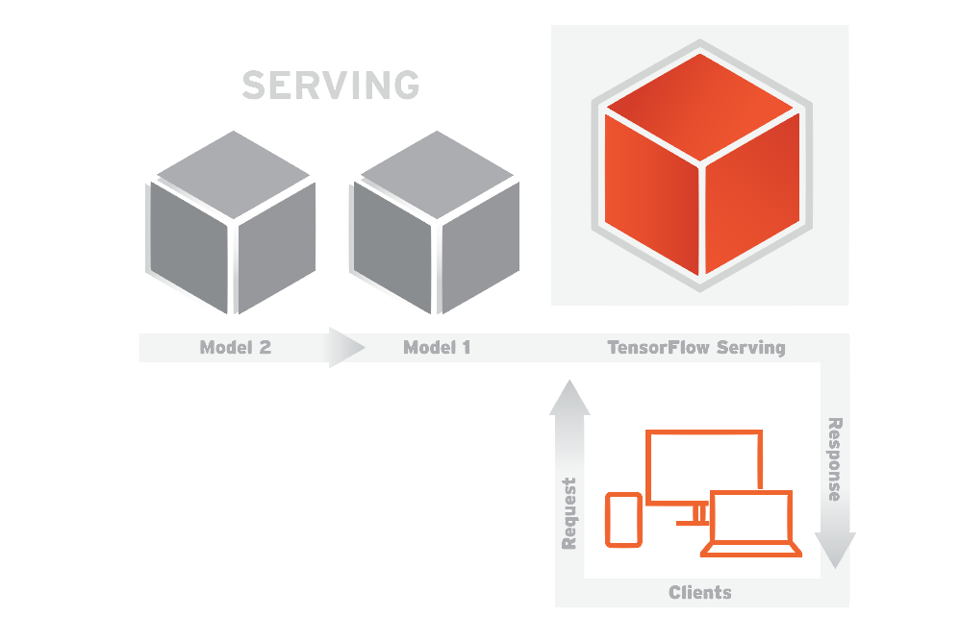
TensorFlow Serving

Slide 24
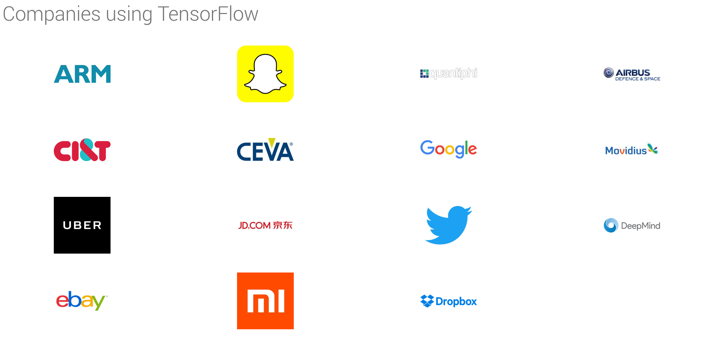
Source: tensorflow.org

Slide 25
Course Outline

Slide 26
Structure
6 weeks, two nights a week
Class is one part lecture, one part lab
Pair programming in lab
Reading, quizzes, project

Slide 27
0 - Math Refresher
Linear algebra
Derivative calculus
Probability
1 - TensorFlow & Machine Learning
Introduction to TensorFlow
Elements of ML
Training first models

Slide 28
2 - Feedforward Neural Networks
Activation functions
Backpropagation
Optimization algorithms
3 - Convolutional Networks
Convolutional kernels
Residual connections
Inception modules
Classification and detection
Transfer learning

Slide 29
4 - Recurrent Networks
Recurrent connections
LSTMs and GRUs
Word vector encodings
Image descriptions
5 - Deployment
Finalizing, exporting, and bundling models
Prototyping with Flask
TensorFlow Serving and gRPC

Slide 30
Outcomes

Slide 31
Gain intuition for deep learning methods

Slide 32
Implement modern architectures in TF

Slide 33
Learn to read papers to build new models

Slide 34
thisismetis.com/deep-learning-with-tensorflow/enroll

Slide 35
Thank you!
thisismetis.com/deep-learning-with-tensorflow/enroll

